Slide 1
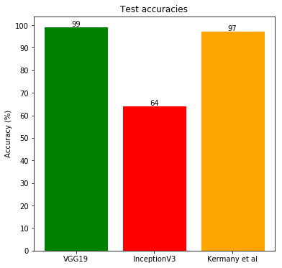
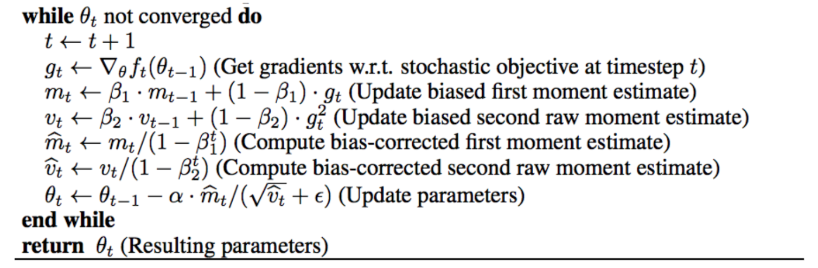
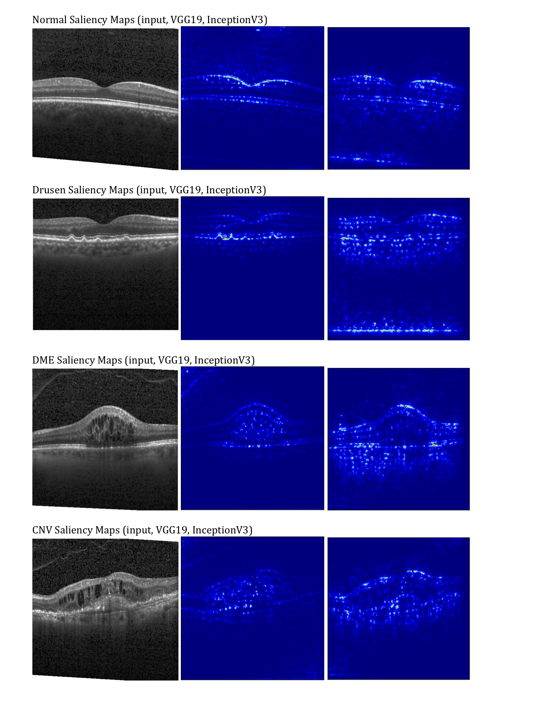
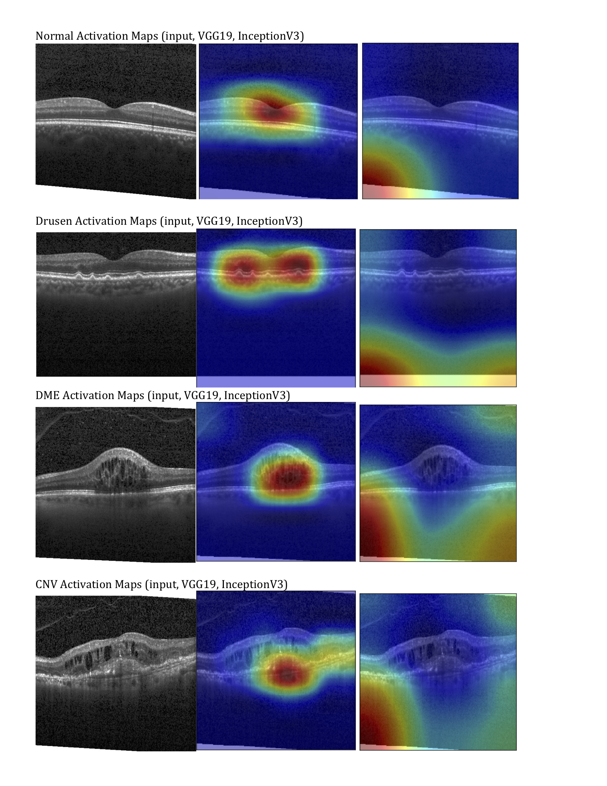
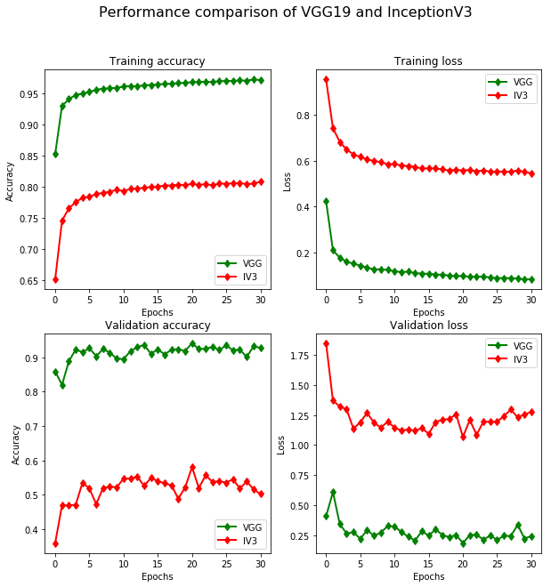
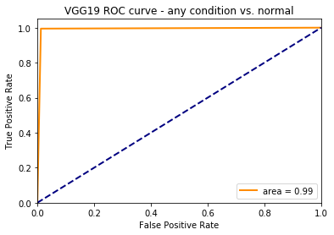
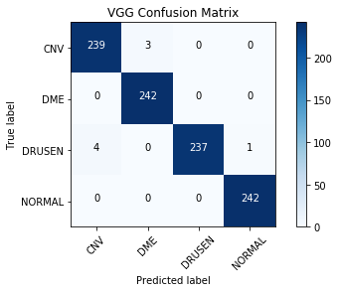
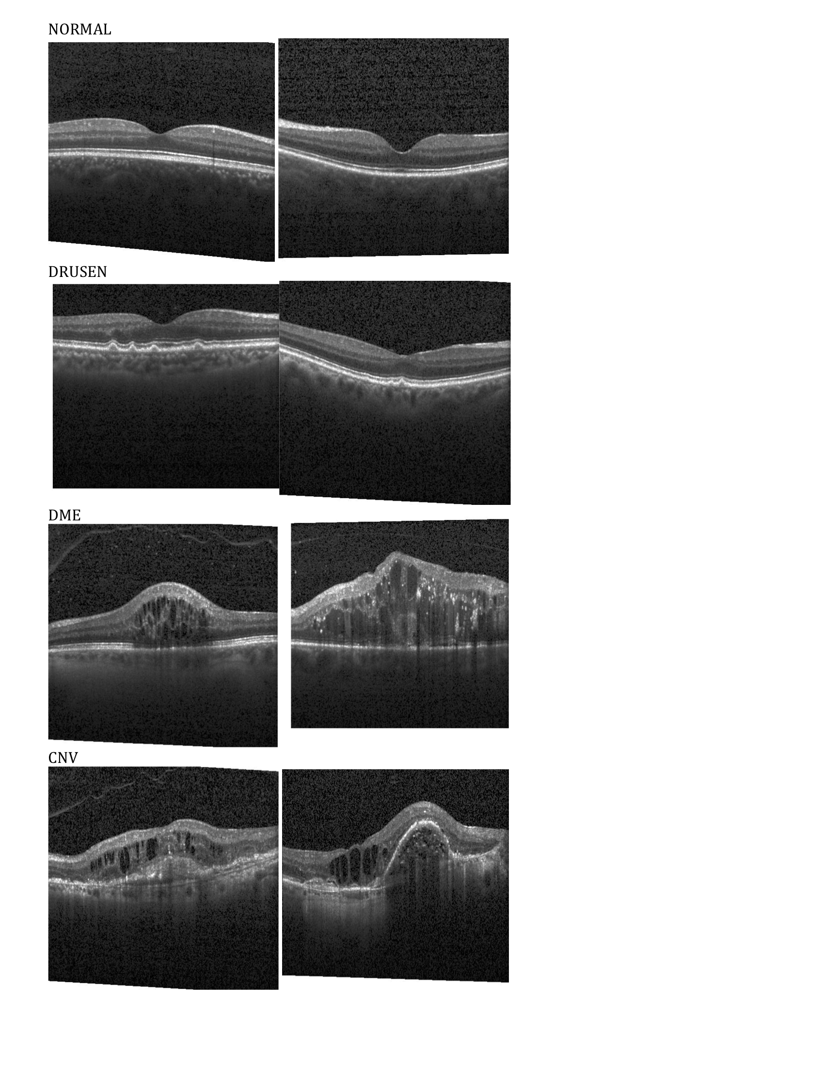
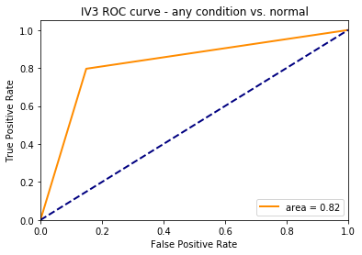
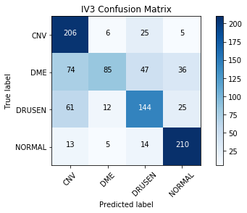
Diagnosing Retinal Pathology from Optical Coherence Tomography Using VGG19 and InceptionV3
Rafi Ayub, Rafid Sikder
CS 231N Project
Stanford University
Introduction
Methods
Millions of people suffer from and develop age related macular degeneration (AMD), diabetic macular edema (DME), and choroidal neovascularization (CNV) [1].
In order to administer these medications, optical coherence tomography (OCT) is needed to provide a clear cross-sectional representation of the retina.
Potential applications of deep learning in medical imaging by applying VGG19 and InceptionV3 architectures towards the analysis of OCT images can help in predicting the retinal condition and expedite the diagnosis process.
Algorithm for Adam optimizer with bias correction, adapted from [2]
Related Work
The model was trained with stochastic gradient descent using an Adam Optimizer on batches of 1000 images.
The Unlike the method of steepest gradient descent (SGD), with momentum updates, Adam adaptively tunes learning rate per parameter and enjoys efficient convergence.
Previous studies have investigated classifying three retinal pathologies from normal pathology – CNV, DME and drusens – using an IV3 architecture.
Investigators achieved accuracy of 96.6% on test dataset and a diagnostic ability statistically similar to human experts within a 95% confidence interval.
VGG architecture has been successfully applied in ophthalmology in recent studies
Experiments & Results
Dataset
We produced saliency maps of both models indicating which pixels in each sample image contribute most to class score.
We also produced activation maps of both models indicating image regions CNN classifiers utilized to determine category.
We used images provided in a dataset made publicly available by Kermany et al. [3]
Sample resized retinal OCT images from each class used as inputs to the deep learning models.
Data consisted of 207,130 grayscale OCT images of the retinas of 4,686 patients.
37,206 images with CNV, 11,349 with DME, 8,617 with DRUSEN, and 51,140 that are normal.
Conclusions
Network architectures such as VGG, GoogLeNet, and AlexNet have been successful in categorizing disease and highlight regions of interest.
VGG architecture was 98.6% accurate outclassing IV3 accuracies.
References
Figure on the left is a a graphical representation of the comparison of the VGG19 and InceptionV3 training and validation accuracies and losses.
Confusion matrices for both models. A darker blue indicates more images correctly classified. Precision and recall for VGG was 100% and 99.8%, respectively. Precision and recall for IV3 was 95.4% and 90.9%, respectively.
Receiver operating characteristic curves for each model where a true positive means the classifier detected an abnormal condition successfully. The area under the curve indicates the difference between performances of the two models.
We observed the test accuracies of each model comparing the performances of each model on the test dataset, rounded to the nearest percent.
[1] Friedman, D.S., O’Colmain, B.J., Mun˜ oz, B., Tomany, S.C., McCarty, C., de Jong, P.T., Nemesure, B., Mitchell, P., and Kempen, J.; Eye Diseases Prevalence Research Group (2004). Prevalence of age-related macular degeneration in the United States. Arch. Ophthalmol. 122, 564–572.
[2] Kingma, D. P., & Ba, J. (2014). Adam: A Method for Stochastic Optimization, 1–15. https://doi.org/http://doi.acm.org.ezproxy.lib.ucf.edu/10.1145/1830483.1830503
[3] Kermany, D. S., Goldbaum, M., Cai, W., Valentim, C. C., Liang, H., Baxter, S. L., … Zhang, K. (2018). Identifying Medical Diagnoses and Treatable Diseases by Image-Based Deep Learning. Cell, 172(5), 1122-1131.e9.
Notes:
‹#›

Slide 2

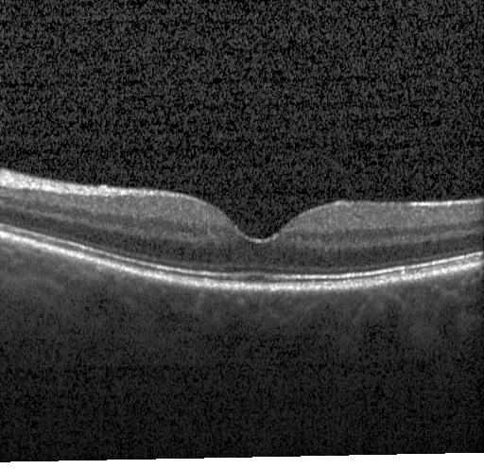
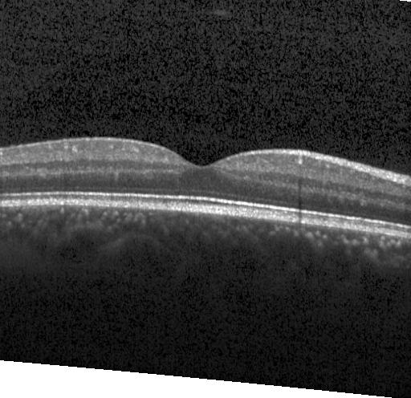

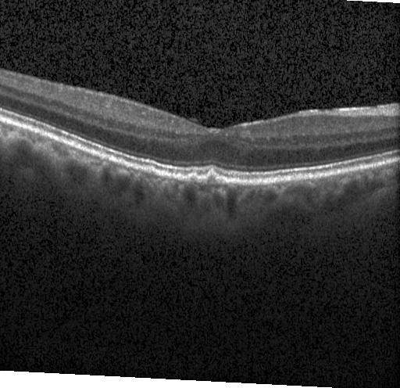
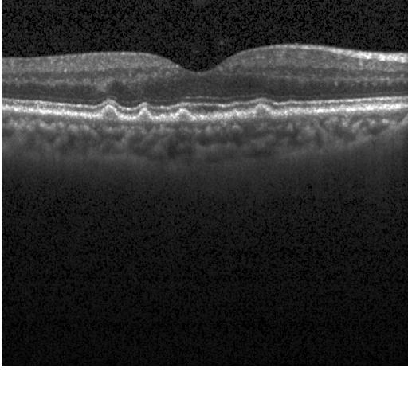
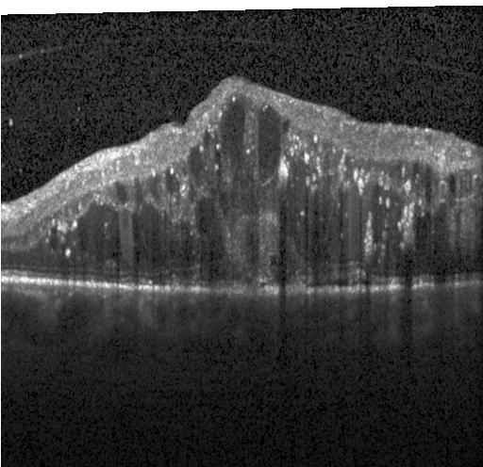
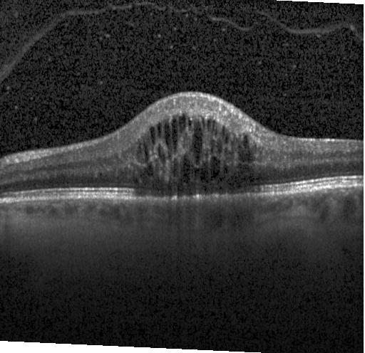
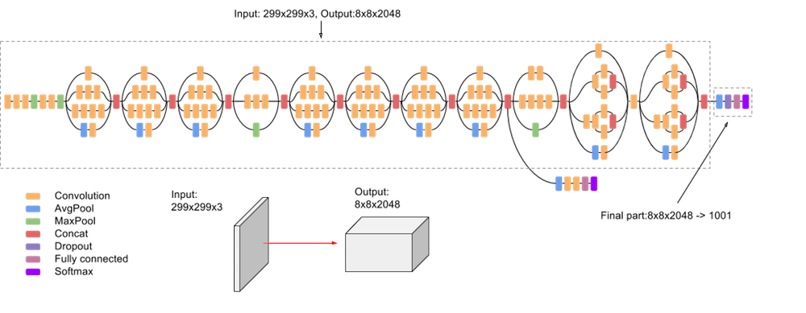
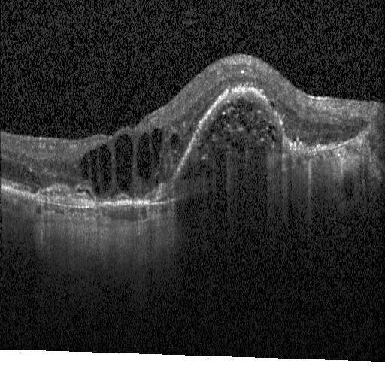
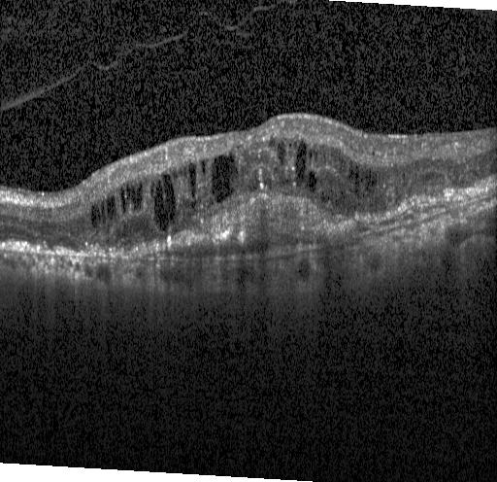
Diagnosing Retinal Pathology from Optical Coherence Tomography with Deep Learning
Rafi Ayub¹, Rafid Sikder²
¹Department of Bioengineering
²Institute for Computational and Mathematical Engineering
Introduction
Results and Discussion
Background
About 10 million people suffer from age related macular degeneration (AMD), 750,000 from diabetic macular edema (DME), and 200,000 develop choroidal neovascularization (CNV) [1] [2].
Optical coherence tomography (OCT) is critical to image retina for diagnosis
Problem
Increasing demand of imaging studies outpace the capacity of practicing radiologists
Current manual procedure requires many skilled people, a lot of time, and is computationally expensive [3]
Solution
Deep learning approaches can be used to classify pathology, expediting the process and leading to more favorable clinical outcomes
Figure 4: Saliency maps of both models indicating which pixels in each sample image contribute most to class score.
Methods
Figure 1: Comparison of the VGG19 and InceptionV3 training and validation accuracies and losses.
Figure 2: Confusion matrices and ROC curves for both models. Precision and recall for VGG was 100% and 99.8%, respectively. Precision and recall for IV3 was 95.4% and 90.9%, respectively.
Model Training
Transfer learning with stochastic gradient descent on VGG19 and InceptionV3 architectures pretrained on ImageNet
Data augmentation used to randomly transform position and orientation to expand dataset
Visualization
Saliency maps and class activation maps used to visualize networks
InceptionV3 consistently performed worse than VGG by 20% in training accuracy, 40% in validation accuracy, despite its touted ability to capture finer features within the images
IV3 model misclassifications and class activation maps indicate that the model is not picking up important features in the images and could have been trained incorrectly
VGG19 performed better than previous study [4] and IV3 on test dataset, and can identify pathophysiologically relevant features
Pretrained weights
CNV
Normal
VGG19
DME
Training
NORMAL
Drusens
Predict
DRUSEN
GoogLeNet/InceptionV3
DME
Figure 3: Comparison of performances of each model on the test dataset, rounded to the nearest percent.
Figure 5: Class activation maps of both models indicating image regions CNN classifiers utilized to determine category.
CNV
Conclusions
References
88,484 OCT images from 4,686 patients [4]
Transfer learning can be effectively applied to train deep learning classifiers on medical images
VGG model can successfully determine OCT images containing pathological features
VGG model can be used to highlight physiologically relevant regions of interest to assist practitioner
Friedman, D.S., O’Colmain, B.J., Mun˜ oz, B., Tomany, S.C., McCarty, C., de Jong, P.T., Nemesure, B., Mitchell, P., and Kempen, J.; Eye Diseases Prevalence Research Group (2004). Prevalence of age-related macular degeneration in the United States. Arch. Ophthalmol. 122, 564–572.
Wong, W.L., Su, X., Li, X., Cheung, C.M., Klein, R., Cheng, C.Y., and Wong, T.Y. (2014). Global prevalence of age-related macular degeneration and disease burden projection for 2020 and 2040: a systematic review and meta-analysis. Lancet Glob. Health 2, e106–e116.
Smieliauskas F, MacMahon H, Salgia R, Shih Y-CT. Geographic variation in radiologist capacity and widespread implementation of lung cancer CT screening. J Med Screen. 2014;21:207e215. 11.
Kermany, D. S., Goldbaum, M., Cai, W., Valentim, C. C., Liang, H., Baxter, S. L., … Zhang, K. (2018). Identifying Medical Diagnoses and Treatable Diseases by Image-Based Deep Learning. Cell, 172(5), 1122-1131.e9.
VGG19 | InceptionV3
Batches of 128 images | Batches of 1000 images
SGD w/ momentum | Adam
FC layers re-trained | Only classifier re-trained

